Slide 1
The reconstruction amendments
Constitutional Law I
Assignment #68
April 14, 2026

Slide 2
The Reconstruction Amendments
Amendment | Date ratified | Main ideas
13th | 1865 | Abolished slavery Gives Congress enforcement power
14th | 1868 | Establishes birthright citizenship Bars states from denying due process, equal protection, & privileges and immunities of national citizenship Addresses status of officials involved in rebellion & confederate debts Gives Congress enforcement power
15th | 1870 | Prohibits denial of right to vote on race, color, & previous servitude Gives Congress enforcement power

Slide 3
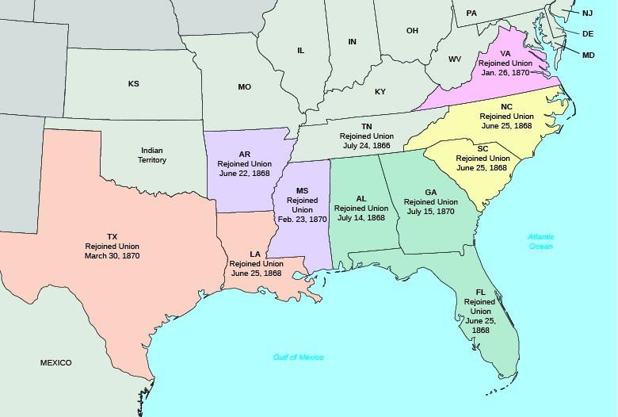
States of the Confederacy and
Readmission to the Union

Slide 4
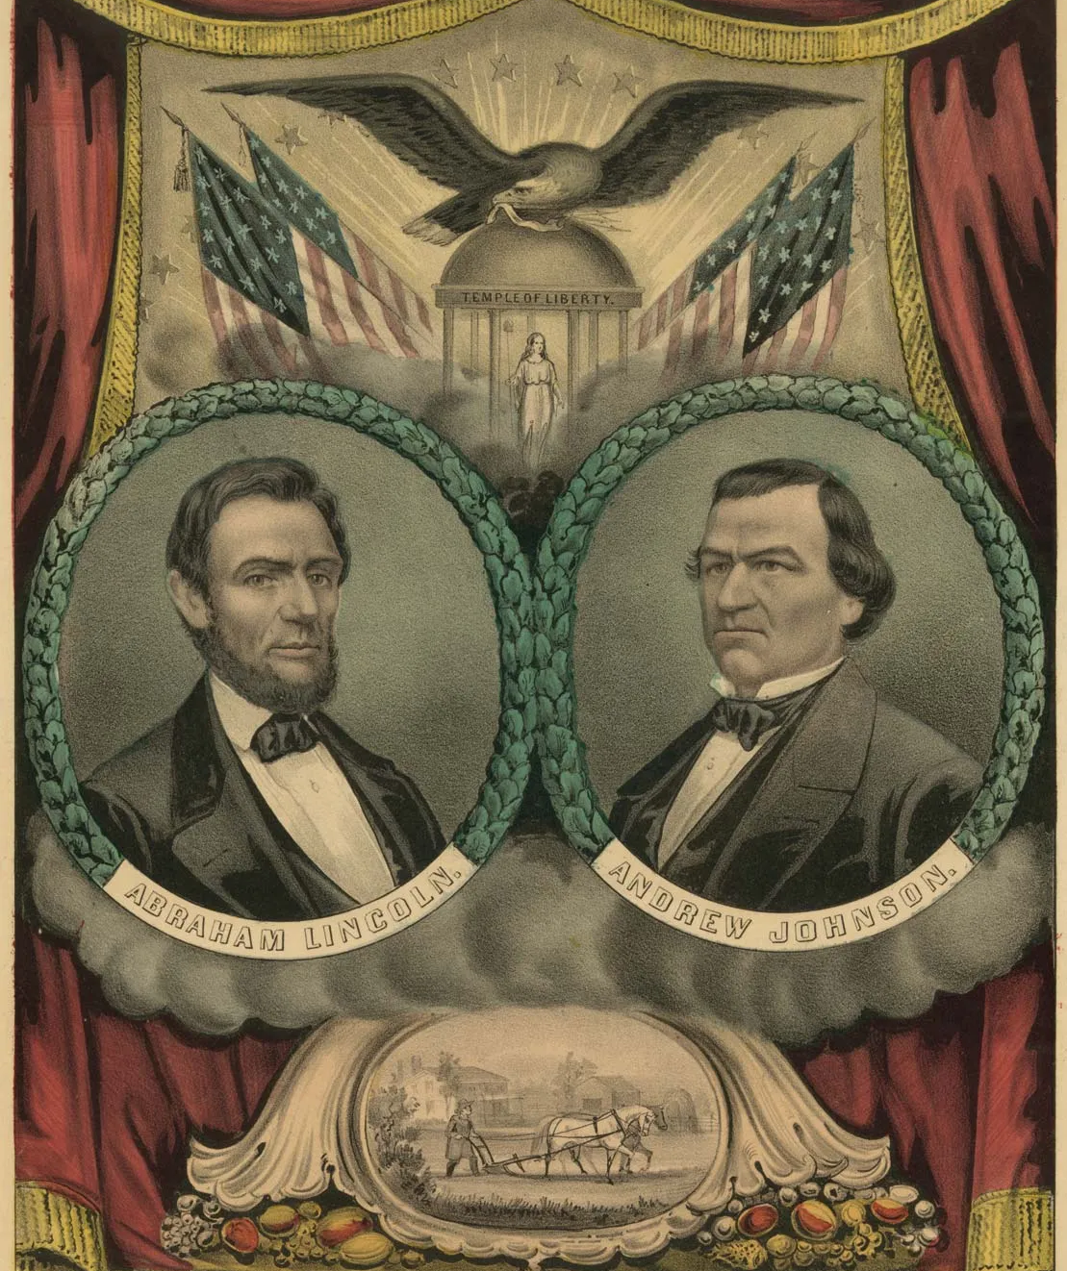
Presidents Abraham Lincoln (1861-65) and Andrew Johnson (1865-69)

Slide 5
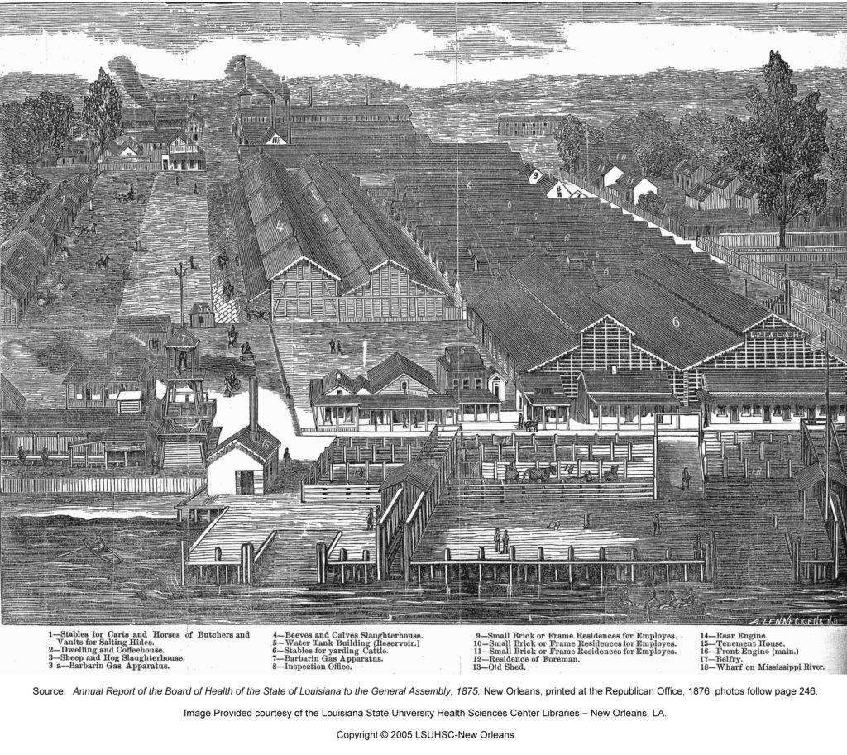

Slide 6
Applying the 14th Amendment:
The Slaughter-House Cases (1873)
Suit brought by butchers in New Orleans, objecting to local law restricting operation of slaughterhouses.
Butchers claim law violates 13th and 14th amendments.
Supreme Court denies claim.
  Emphasizes historical context of Reconstruction Amendments: addressing slavery and denial of freedmen’s fundamental rights
  Adopts very limited construction of 14th amendment Privileges and Immunities clause:
    Finds P&I of national citizenship to include right to come to seat of government ; access seaports; petition government; etc.

Slide 7
Working around the Slaughter-House Cases
The Slaughter-House Cases (with Cruikshank (1876) effectively killed the 14th Amendment Privileges and Immunities Clause as a tool for protecting rights.
In the twentieth century, the Court enlisted the 14th Amendment Due Process Clause to do the work the P&I Clause was probably intended to do: requiring states to respect constitutional rights
In a series of decisions, the Supreme Court held that most of the rights in the Bill of Rights are “incorporated against” the states through the Due Process Clause of the 14th amendment

Slide 8
The power here exercised by the legislature of Louisiana is, in its essential nature, one which has been, up to the present period in the constitutional history of this country, always conceded to belong to the States . . .
the one pervading purpose found in [the Reconstruction Amendments is] the freedom of the slave race, the security and firm establishment of that freedom, and the protection of the newly made freeman and citizen from the oppressions of those who had formerly exercised unlimited dominion over him.
in any fair and just construction of any section or phrase of these amendments, it is necessary to look to the purpose which we have said was the pervading spirit of them all,
there is a citizenship of the United States, and a citizenship of a State, which are distinct from each other, and which depend upon different characteristics or circumstances in the individual.
the privileges and immunities of citizens of the several States . . .[are] those . . . which are fundamental; which belong of right to the citizens of all free governments,
when the effect is to fetter and degrade the State governments by subjecting them to the control of Congress in the exercise of powers heretofore universally conceded to them of the most ordinary and fundamental character; when, in fact, it radically changes the whole theory of the relations of the State and Federal governments to each other and of both these governments to the people . . . We are convinced that no such results were intended.
[enumeration of privileges and immunities of national citizenship on page 1399]

Slide 9
The reconstruction amendments (con’t)
Constitutional Law I
Assignment #69
April 16, 2026

Slide 10
Working around the Slaughter-House Cases
The Slaughter-House Cases (with Cruikshank (1876) effectively killed the 14th Amendment Privileges and Immunities Clause as a tool for protecting rights.
In the twentieth century, the Court enlisted the 14th Amendment Due Process Clause to do the work the P&I Clause was probably intended to do: requiring states to respect constitutional rights
In a series of decisions, the Supreme Court held that most of the rights in the Bill of Rights are “incorporated against” the states through the Due Process Clause of the 14th amendment

Slide 11
Applying the 14th Amendment:
The Civil Rights Cases (1883)
In the Civil Rights Act of 1875, Congress required places of public accommodation (inns, theaters, public conveyances, etc.) to serve citizens regardless of race, under penalty of civil and criminal sanctions.
The Supreme Court held the Civil Rights Act exceeded Congress’s power under the 13th and 14th Amendments
  The Court held that the guarantees of the 14th Amendment applied only to state action, as opposed to action by private parties
  In enforcing the 14th Amendment, Congress cannot go beyond what the Amendment prohibits

Slide 12
Yick Wo: the challenged ordinance
SEC. 1. It shall be unlawful, from and after the passage of this order, for any person or persons to establish, maintain, or carry on a laundry within the corporate limits of the city and county of San Francisco without having first obtained the consent of the board of supervisors, except the same be located in a building constructed either of brick or stone."
. . .
SEC. 3. Any person who shall violate any of the provisions of this order shall be deemed guilty of a misdemeanor, and upon conviction thereof shall be punished by a fine of not more than one thousand dollars, or by imprisonment in the county jail not more than six months, or by both such fine and imprisonment.

Slide 13
Representation and Republicanism
Constitutional Law I
Assignment #39
April 21, 2026

Slide 14
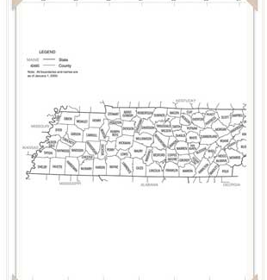
Electoral Districts in TN

Slide 15
Political Question Doctrine
List of scenarios from Baker v. Carr (1962):
a textually demonstrable constitutional commitment of the issue to a coordinate political department;
or a lack of judicially discoverable and manageable standards for resolving it;
or the impossibility of deciding without an initial policy determination of a kind clearly for nonjudicial discretion;
or the impossibility of a court's undertaking independent resolution without expressing lack of the respect due coordinate branches of government;
or an unusual need for unquestioning adherence to a political decision already made;
or the potentiality of embarrassment from multifarious pronouncements by various departments on one question.”

Slide 16
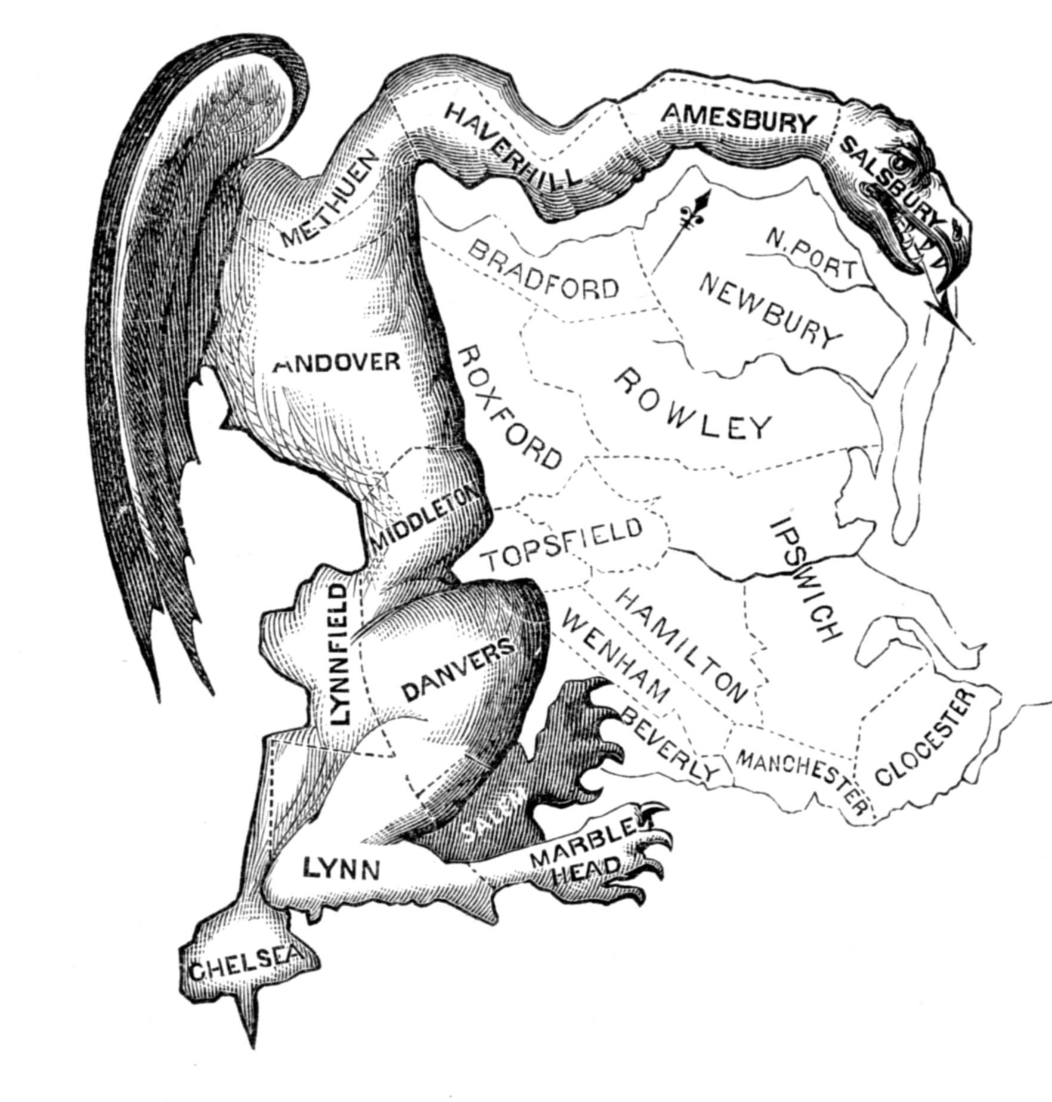
The Original Gerrymander

Slide 17
The Constitution and Representation:
Some Vocabulary
Malapportionment: The unequal distribution of representatives in legislative bodies
Gerrymander: the manipulation of voting district lines for improper ends.
  Partisan gerrymander: seeks to advantage a particular party.
  Racial gerrymander: seeks to advantage a particular race.
  Incumbency protection gerrymander: seeks to protect incumbents.

Slide 18
National citizenship & the 14th amendment
Constitutional Law I
April 23, 2026

Slide 19
https://www.govinfo.gov/content/pkg/USCODE-2024-title8/pdf/USCODE-2024-title8-chap12-subchapIII-partI-sec1401.pdf
https://www.documentcloud.org/documents/25995125-orders-in-birthright-citizenship-case/
https://www.oyez.org/cases/2025/25-365

