Slide 1
Article I: The legislative power
Constitutional Law I
Assignment #4
January 17, 2026

Slide 2
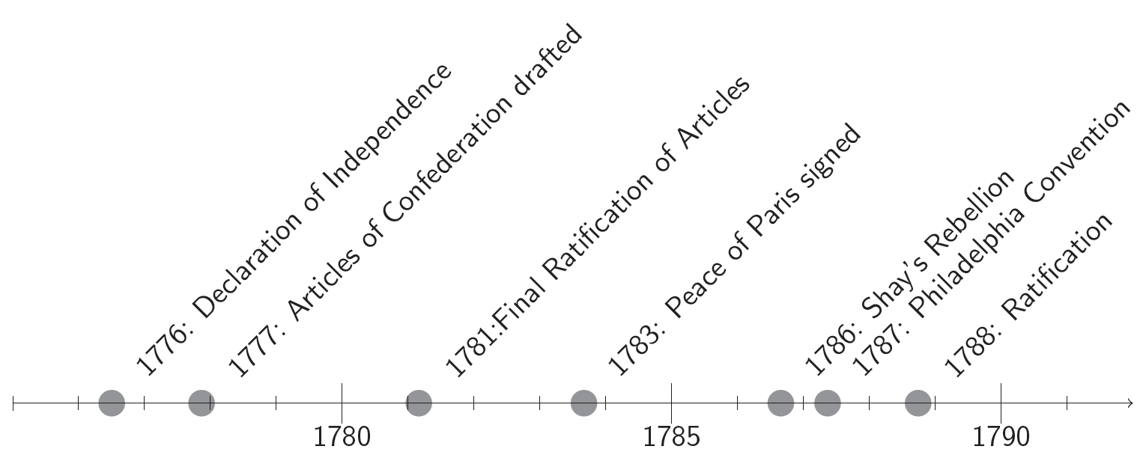

Slide 3
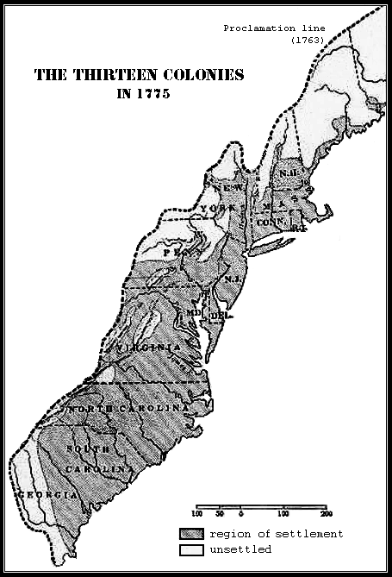

Slide 4
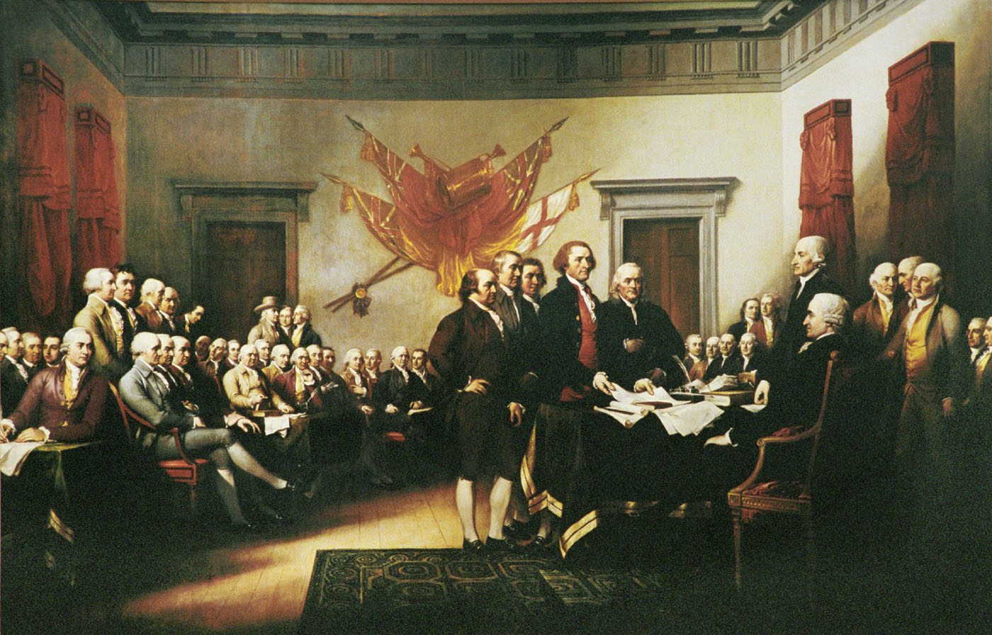
Declaration of Independence (1776)

Slide 5
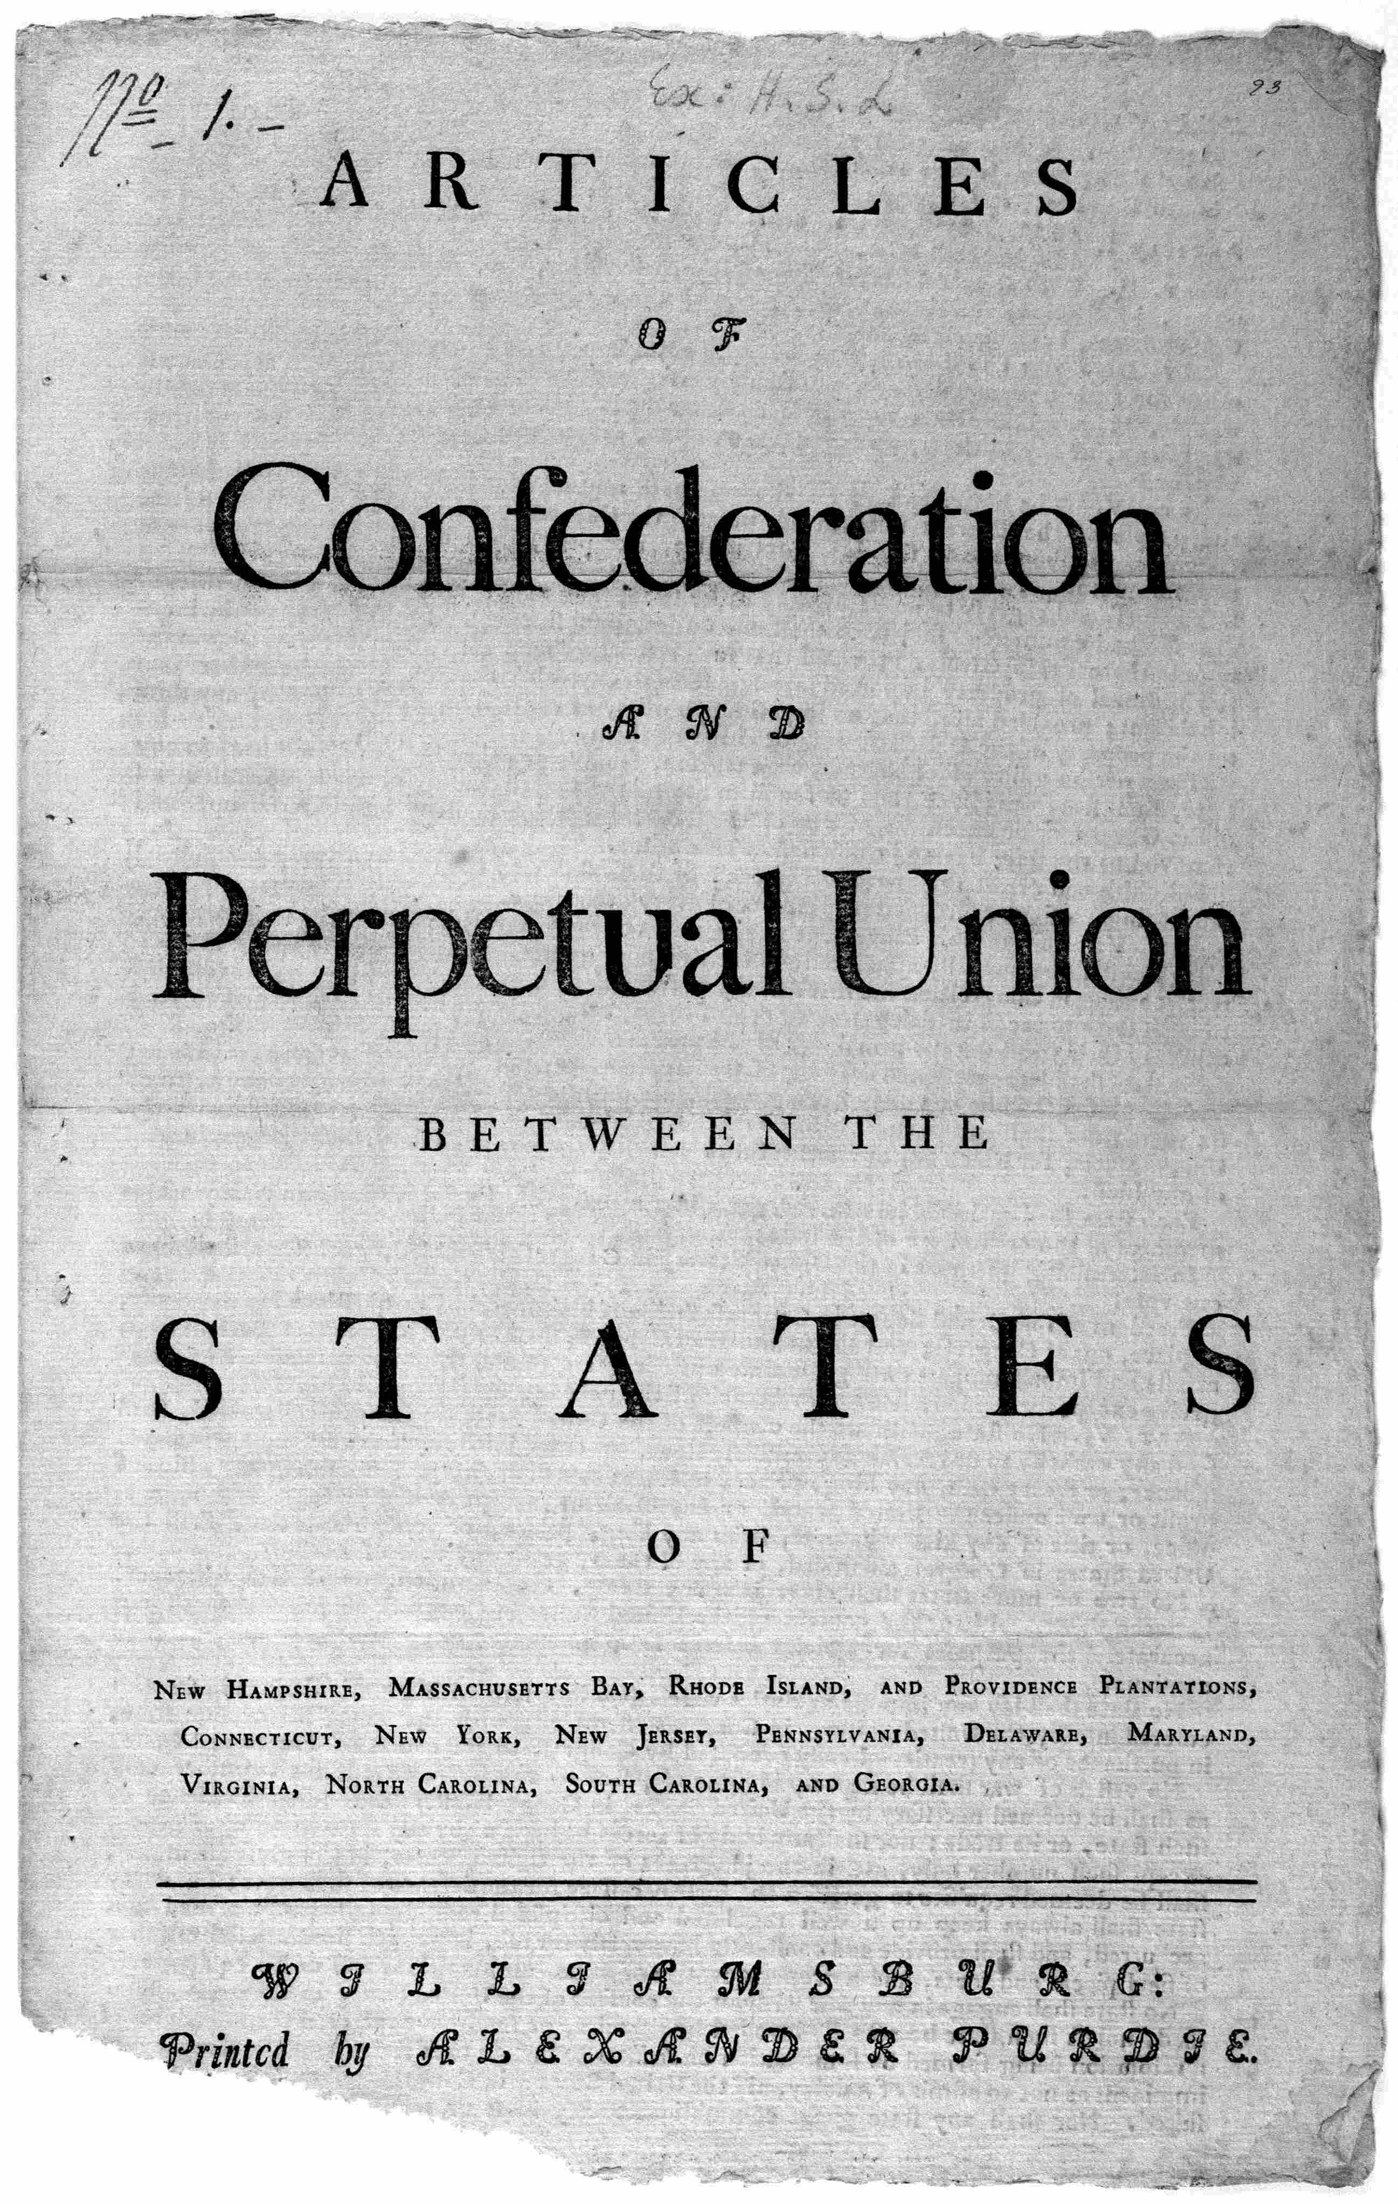
The Articles of Confederation
(1777; ratified 1781)

Slide 6
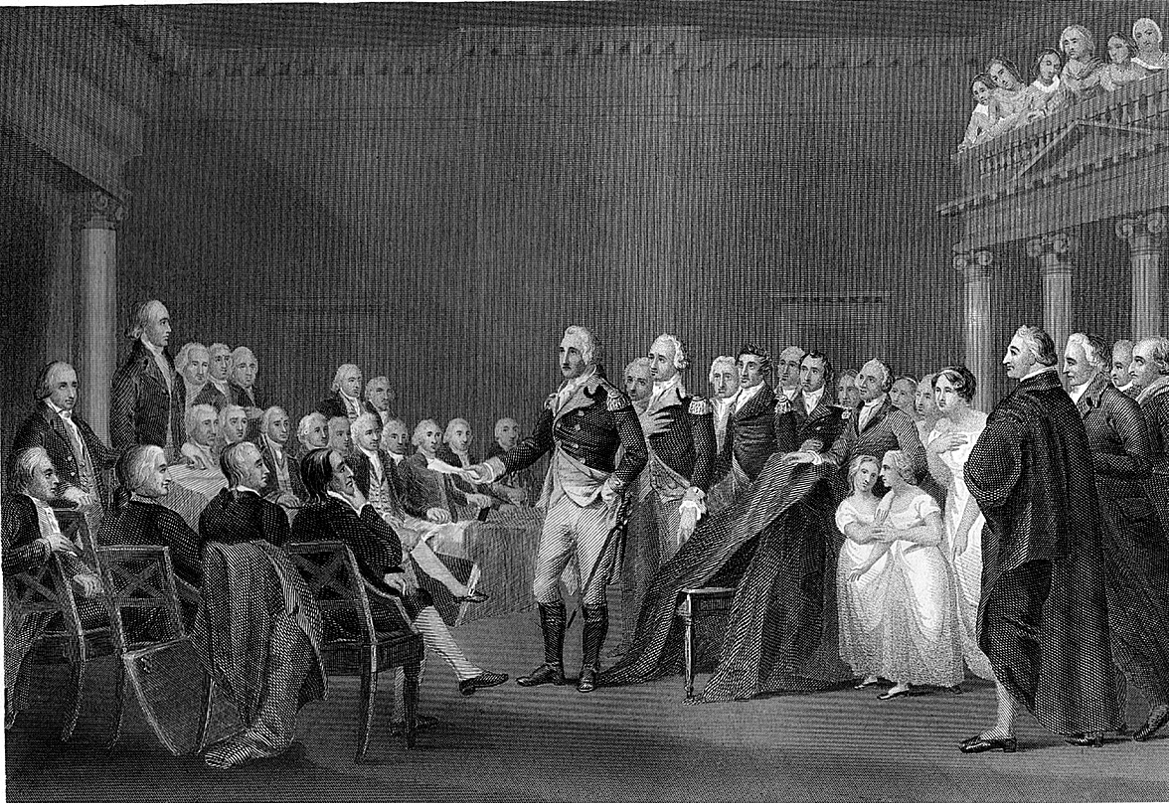
End of the Revolutionary War:
Treaty of Paris (1783)

Slide 7

Shays’ Rebellion (1786)

Slide 8
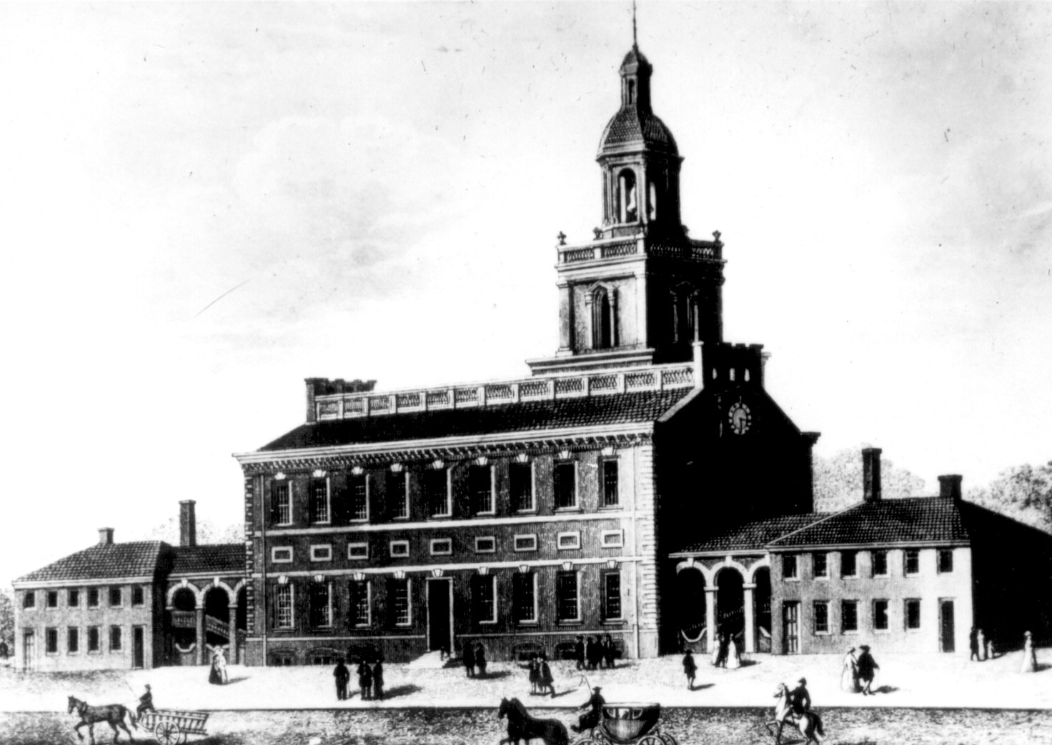
Independence Hall, Philadelphia

Slide 9
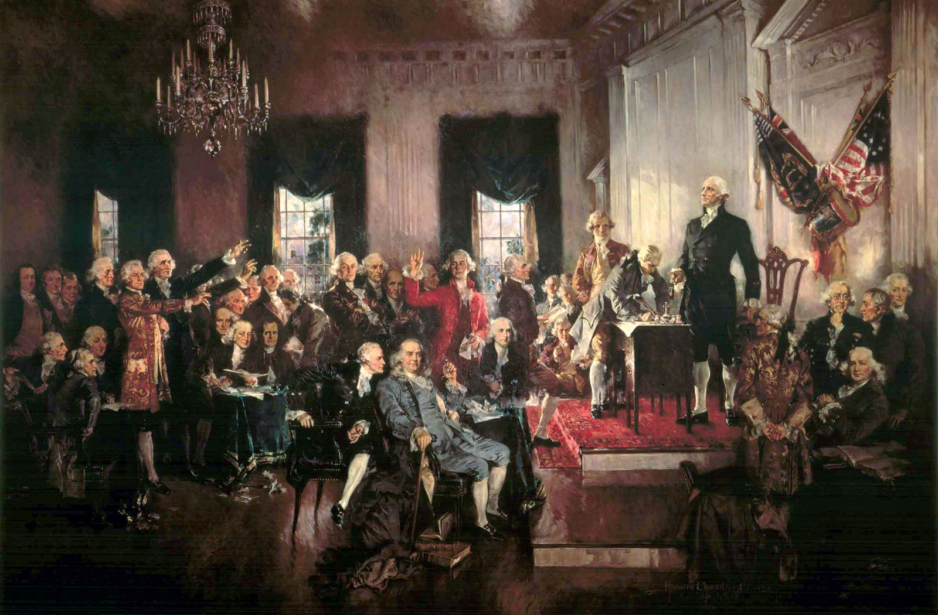
Signing of the Constitution (1787)

Slide 10
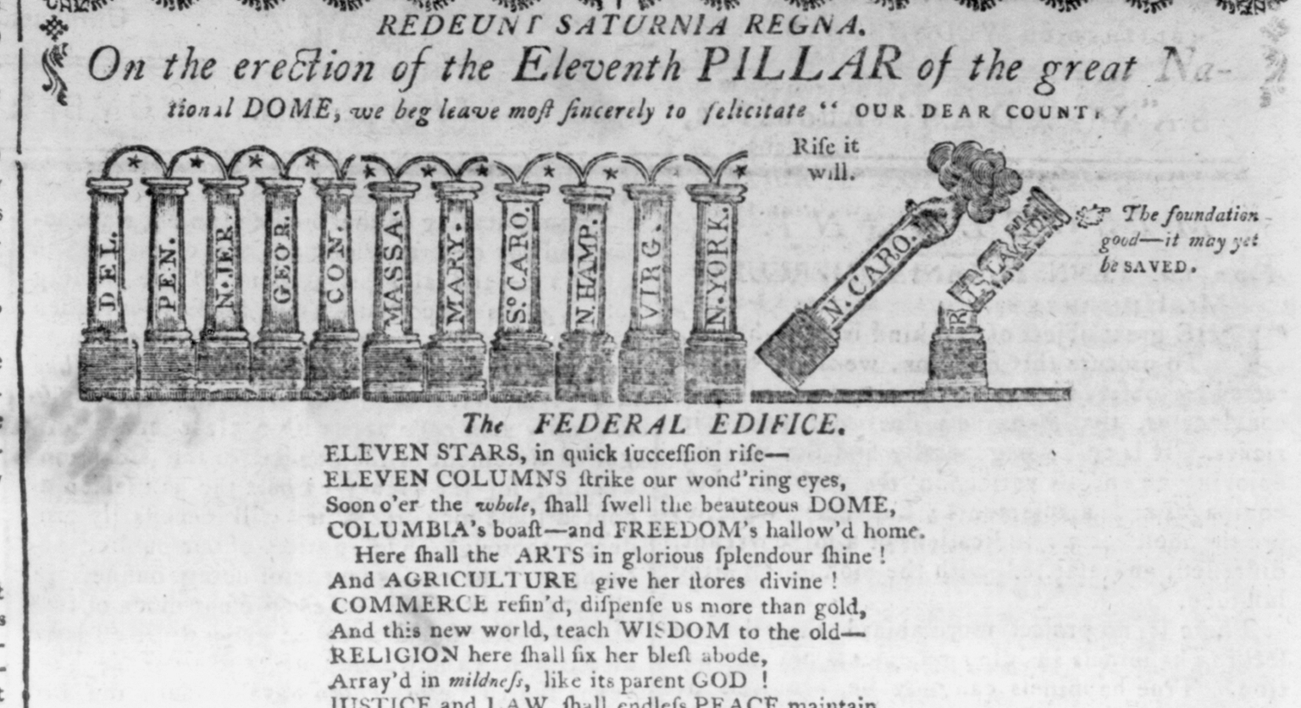
Ratification (1788)

Slide 11
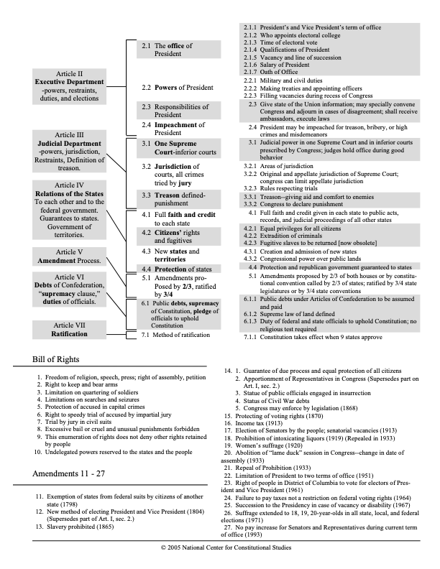
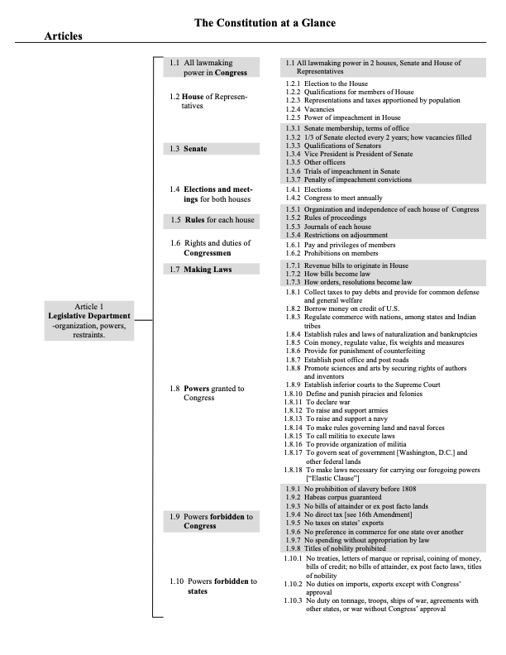

Slide 12
Article I, Section I
All legislative Powers herein granted shall be vested in a Congress of the United States, which shall consist of a Senate and House of Representatives.
Some questions:
Can Congress delegate legislative power?
What is the argument about why doing so would be inconsistent with Article I, Section I?
What is the test for whether a congressional grant of power is permissible? (or: where is the line between legislative and executive power?)

Slide 13
https://c2.bibtopia.com/h/183/188/1434188183.0.x.jpg
https://judmathews.net/wp-content/uploads/2026/01/us-constitution.pdf
https://judmathews.net/the-u-s-constitution-2/

Slide 14
Katz room 112/114/116
(74 total seats)
U2
U1
T1
U3
T2
T3
V3
S3
V2
Q1
P1
Q2
P2
S2
V1
Q3
P3
R4
S1
O4
R3
L1
K1
K2
O3
L2
R2
L3
K3
O2
L4
K4
O1
R1
M1
G1
F1
J3
M2
G2
F2
J2
M3
G3
F3
G4
J1
N4
C1
B1
F4
H4
C2
B2
I4
E4
N3
H3
D3
A3
I3
E3
N2
H2
D2
A2
E2
I2
N1
H1
D1
A1
E1
I1
Podium

Slide 15
The business of congress
Constitutional Law I
Assignment #5
January 20, 2026

Slide 16
Gundy v. United States: the provision at issue
34 U.S.C. § 20913, Sex Offender Registration and Notification Act (SORNA)
(d) Initial registration of sex offenders unable to comply with subsection (b)
The Attorney General shall have the authority to specify the applicability of the requirements of this subchapter to sex offenders convicted before the enactment of this chapter or its implementation in a particular jurisdiction, and to prescribe rules for the registration of any such sex offenders and for other categories of sex offenders who are unable to comply with subsection (b).

Slide 17
Gundy: the Intelligible Principle Test
So we have held, time and again, that a statutory delegation is constitutional as long as Congress “lay[s] down by legislative act an intelligible principle to which the person or body authorized to [exercise the delegated authority] is directed to conform.” Ibid. (quoting J. W. Hampton, Jr., & Co. v. United States, 276 U.S. 394, 409 (1928); brackets in original).
. . .
Or in a related formulation, the Court has stated that a delegation is permissible if Congress has made clear to the delegee “the general policy” he must pursue and the “boundaries of [his] authority.” American Power & Light, 329 U. S., at 105.

Slide 18
The Gundy dissent
Justice Gorsuch identifies three scenarios where delegations are permissible:
as long as Congress makes the policy decisions when regulating private conduct, it may authorize another branch to “fill up the details.”
once Congress prescribes the rule governing private conduct, it may make the application of that rule depend on executive fact-finding.
Congress may assign the executive and judicial branches certain non-legislative responsibilities.

Slide 19
Powell v. McCormack: Justiciability
In this case, involves two determinations:
Are claim presented & relief sought of the type which admit of judicial resolution
Is the issue a political question: one not justiciable because of separation of powers

Slide 20
Political Question Doctrine
List of scenarios from Baker v. Carr (1962):
a textually demonstrable constitutional commitment of the issue to a coordinate political department;
or a lack of judicially discoverable and manageable standards for resolving it;
or the impossibility of deciding without an initial policy determination of a kind clearly for nonjudicial discretion;
or the impossibility of a court's undertaking independent resolution without expressing lack of the respect due coordinate branches of government;
or an unusual need for unquestioning adherence to a political decision already made;
or the potentiality of embarrassment from multifarious pronouncements by various departments on one question.”

Slide 21
U.S. Term Limits, Inc. v Thornton:
Amendment 73 § 3
(a) Any person having been elected to three or more terms as a member of the United States House of Representatives from Arkansas shall not be certified as a candidate and shall not be eligible to have his/her name placed on the ballot for election to the United States House of Representatives from Arkansas.

Slide 22
U.S. Term Limits, Inc. v Thornton:
Amendment 73 preamble
The people of Arkansas find and declare that elected officials who remain in office too long become preoccupied with reelection and ignore their duties as representatives of the people. Entrenched incumbency has reduced voter participation and has led to an electoral system that is less free, less competitive, and less representative than the system established by the Founding Fathers. Therefore, the people of Arkansas, exercising their reserved powers, herein limit the terms of elected officials.

Slide 23
Composition of Congress: provisions
https://prezi.com/view/HDvnXLcbxs2rABA4IK1v/
https://www.c-span.org/clip/house-proceeding/oath-of-office-in-the-house-of-representatives/5147615
https://judmathews.net/the-u-s-constitution-2/

Slide 24
Bicameralism and presentment
Constitutional Law I
Assignment #6
January 22, 2026

Slide 25
Section 244(a)(1) of Immigration & Nationality Act
As hereinafter prescribed in this section, the Attorney General may, in his discretion, suspend deportation and adjust the status to that of an alien lawfully admitted for permanent residence, in the case of an alien who applies to the Attorney General for suspension of deportation and --
(1) is deportable under any law of the United States except the provisions specified in paragraph (2) of this subsection; has been physically present in the United States for a continuous period of not less than seven years immediately preceding the date of such application, and proves that during all of such period he was and is a person of good moral character; and is a person whose deportation would, in the opinion of the Attorney General, result in extreme hardship to the alien or to his spouse, parent, or child, who is a citizen of the United States or an alien lawfully admitted for permanent residence.

Slide 26
Section 244(c)(1) of Immigration & Nationality Act
Upon application by any alien who is found by the Attorney General to meet the requirements of subsection (a) of this section the Attorney General may in his discretion suspend deportation of such alien. If the deportation of any alien is suspended under the provisions of this subsection, a complete and detailed statement of the facts and pertinent provisions of law in the case shall be reported to the Congress with the reasons for such suspension. Such reports shall be submitted on the first day of each calendar month in which Congress is in session."

Slide 27
Section 244(c)(2) of Immigration & Nationality Act
(2) In the case of an alien specified in paragraph (1) of subsection (a) of this subsection --
if during the session of the Congress at which a case is reported, or prior to the close of the session of the Congress next following the session at which a case is reported, either the Senate or the House of Representatives passes a resolution stating in substance that it does not favor the suspension of such deportation, the Attorney General shall thereupon deport such alien or authorize the alien's voluntary departure at his own expense under the order of deportation in the manner provided by law. If, within the time above specified, neither the Senate nor the House of Representatives shall pass such a resolution, the Attorney General shall cancel deportation proceedings.

Slide 28
Chadha’s argument
https://www.youtube.com/watch?v=SZ8psP4S6BQ

Slide 29
Appropriations
https://www.congress.gov/bill/119th-congress/house-bill/7148/text

Slide 30
The Power of the Purse
Constitutional Law I
Assignment #7
January 23, 2026

Slide 31
Appropriations etc.: Vocabulary
Authorizing legislation
  Establishes or continues the operation of a federal program or agency
Appropriation legislation
  Provides legal authority for federal agencies to incur obligations and to make payments out of the Treasury for specified purposes. Different kinds:
    Permanent (aka continuing) appropriation: effective on an ongoing basis, with no new action needed from Congress
    Current appropriation: allows an agency to obligate funds only in the year or years for which they are appropriated

Slide 32
The Doctrine of Constitutional Avoidance
“Even if a serious doubt of [a statute’s] unconstitutionality is raised, it is a cardinal principle that this Court will first ascertain whether a construction of the statute is fairly possible by which the question may be avoided.”
- Ashwander v. Tennessee Valley Authority,
297 U.S. 288 (1936)

Slide 33
Trump v. Mazars: when may Congress subpoena the President’s personal info?
Court must consider:
Whether other sources could reasonably provide info Congress needs in light of legislative purpose

