Slide 1
Article III: The judicial power
Constitutional Law I
Assignment #17
March 17, 2026

Slide 2
Federal Courts State Courts
State supreme court
Intermediate appellate court
Trial courts
U.S. Supreme Court
Circuit courts of appeals
District courts

Slide 3
Art III § 2 mapping
 | Supreme Court Original Jx | Supreme Court Appellate Jx
cases | Ambassadors + | Federal question Jx Admiralty & maritime
controversies | between two or more States between a State and Citizens of another State between a State and foreign States, Citizens or Subjects | Diversity Jx Alienage Jx U.S. as party Citizens of same state claiming lands under different States’ grants

Slide 4
Judiciary Act of 1789
SEC . 13. And be it further enacted, That the Supreme Court shall have exclusive jurisdiction of all controversies of a civil nature, where a state is a party, except between a state and its citizens; and except also between a state and citizens of other states, or aliens, in which latter case it shall have original but not exclusive jurisdiction. And shall have exclusively all such jurisdiction of suits or proceedings against ambassadors, or other public ministers, or their domestics, or domestic servants, as a court of law can have or exercise consistently with the law of nations; and original, but not exclusive jurisdiction of all suits brought by ambassadors, or other public ministers, or in which a consul, or vice consul, shall be a party. And the trial of issues in fact in the Supreme Court, in all actions at law against citizens of the United States, shall be by jury. The Supreme Court shall also have appellate jurisdiction from the circuit courts and courts of the several states, in the cases herein after specially provided for; and shall have power to issue writs of prohibition to the district courts, when proceeding as courts of admiralty and maritime jurisdiction, and writs of mandamus, in cases warranted by the principles and usages of law, to any courts appointed, or persons holding office, under the authority of the United States.

Slide 5
Judicial supremacy & departmentalism
Constitutional Law I
Assignment #17
March 19, 2026

Slide 6
Marbury v. Madison (1803) - background
After losing the election of 1800, President James Madison appoints a number of federal judges, including William Marbury.
The new Secretary of State, James Madison, refuses to deliver to Marbury his commission.
Marbury petitions the Supreme Court for a Writ of Mandamus ordering Madison to deliver the commission.
Section 13 of the Judiciary Act of 1789 gives the Supreme Court power to issue writs of mandamus.

Slide 7
Marbury v. Madison (1803) - holding
Chief Justice Marshall rules for a unanimous Court that:
  Marbury has a right to his commission
  BUT the Supreme Court cannot issue the writ of mandamus, because § 13 of the Judiciary Act is unconstitutional.
    Article III grants the Supreme Court original jurisdiction only over certain kinds of cases.
    The mandamus power is a form of original jurisdiction.
    In granting the Supreme Court a mandamus power, § 13 goes beyond what the Constitution permits.

Slide 8
Marbury v. Madison (1803): judicial review
It is emphatically the province and duty of the Judicial Department to say what the law is. Those who apply the rule to particular cases must, of necessity, expound and interpret that rule. If two laws conflict with each other, the Courts must decide on the operation of each.

Slide 9
Marbury v. Madison (1803): judicial review
So, if a law be in opposition to the Constitution, if both the law and the Constitution apply to a particular case, so that the Court must either decide that case conformably to the law, disregarding the Constitution, or conformably to the Constitution, disregarding the law, the Court must determine which of these conflicting rules governs the case. This is of the very essence of judicial duty.

Slide 10
Marbury v. Madison (1803): judicial review
If, then, the Courts are to regard the Constitution, and the Constitution is superior to any ordinary act of the Legislature, the Constitution, and not such ordinary act, must govern the case to which they both apply.

Slide 11
Missouri Compromise
https://upload.wikimedia.org/wikipedia/commons/8/85/US_Slave_Free_1789-1861.gif

Slide 12
Lincoln-Douglas questions
Why, according to Douglas, is a decision of the Supreme Court “the law of the land”? (What does it mean to be “the law of the land”?)
Lincoln says he opposes the Dred Scott decision, but he does not resist it. What does that mean?

Slide 13
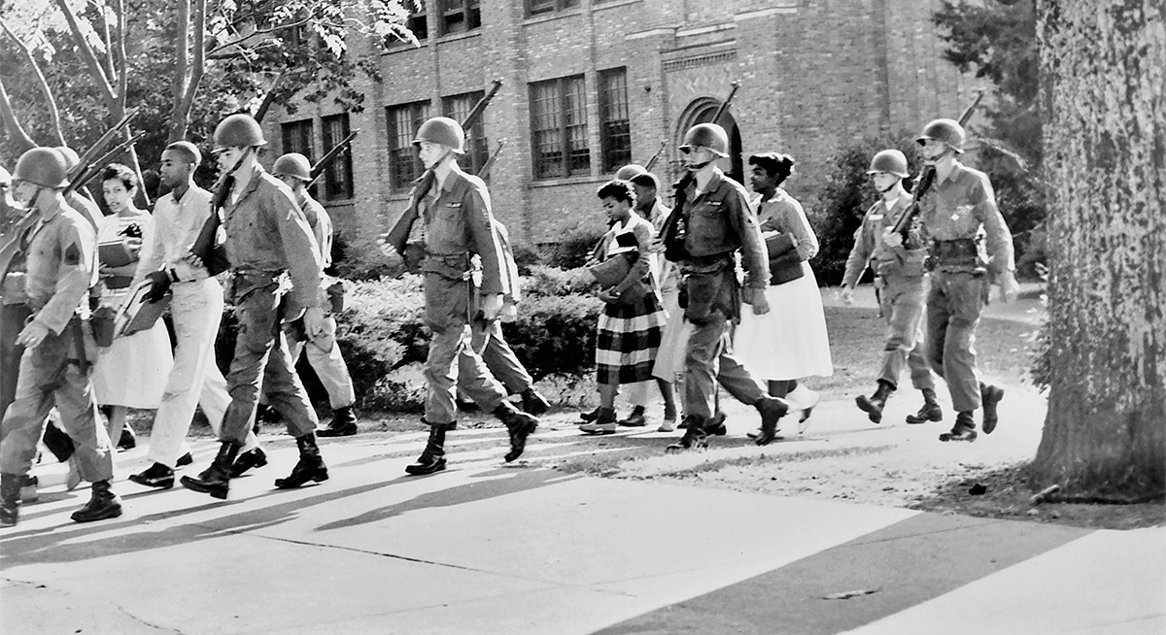
The Little Rock Nine

Slide 14
Justiciability
Constitutional Law I
Assignment #18
March 24, 2026

