Slide 1
INTRODUCTION
Constitutional Law I
January 13, 2026

Slide 2
On your card, please write:
Your name
Your degree program (JD, LLM)
Your hometown
Where you went to college
What you studied in college
What you did after college, if anything
Anything you’d like me to know about you

Slide 3
WHO DECIDES WHAT THE CONSTITUTION MEANS? SOME POSSIBILITIES
INTERPOSITION: Idea that states, acting together, can “interpose” themselves between the federal government and the people, to prevent the federal government from enforcing unconstitutional laws.
NULLIFICATION: Idea that states may declare laws they deem unconstitutional null and void within their borders

Slide 4

Photo credit: Jim Urquhart/Reuters

Slide 5
WHO DECIDES WHAT THE CONSTITUTION MEANS? SOME POSSIBILITIES
POPULAR CONSTITUTIONISM: “The People” decide what the Constitution means. (How, exactly?)

Slide 6
https://web.archive.org/web/20100104003127/http://oathkeepers.org/oath/about/

Slide 7
WHO DECIDES WHAT THE CONSTITUTION MEANS? SOME POSSIBILITIES
JUDICIAL SUPREMACY: Courts’ interpretation of the Constitution are supreme over other institutions’. There are stronger and weaker versions of this idea.

Slide 8
WHO DECIDES WHAT THE CONSTITUTION MEANS? SOME POSSIBILITIES
DEPARTMENTALISM: each branch of government must interpret the Constitution for itself, in the course of carrying out its duties. No branch’s interpretation is necessarily supreme over the others.

Slide 9
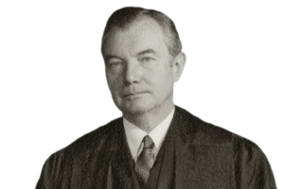
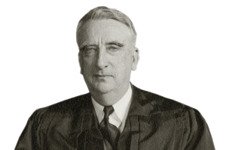
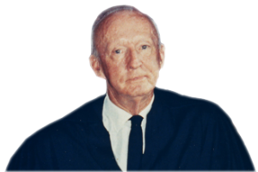
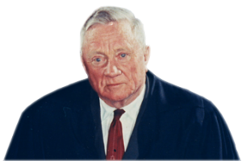
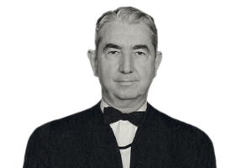
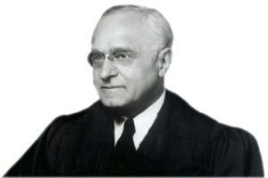
YOUNGSTOWN SHEET AND TUBE CO. v. SAWYER
 | Hugo Black (Opinion of the Court) |  | Robert Jackson (concurrence)
 | Felix Frankfurter (concurrence) |  | Tom C. Clark (concurrence)
 | William O. Douglas (concurrence) |  | Fred M. Vinson (dissent)

Slide 10
TYPES OF CONSTITUTIONAL ARGUMENTS
Textual
Historical
Structural
Precedential
Consequentialist

