Slide 1
Article II: The EXECUTive power
Constitutional Law I
Assignment #9
January 27, 2026

Slide 2
Buckley v. Valeo:
Federal Election Commission composition
2 members nominated by president pro tempore of the Senate
2 members nominated by Speaker of the House of Representatives
2 members nominated by President
All nominees confirmed by majority vote of both Houses of Congress
Secretary of the Senate and the Clerk of the House serve as ex officio nonvoting members

Slide 3
Noel Canning: questions to consider
Both the majority and dissent in this case are mostly about history. Why? Do the majority and dissent use history differently?
Which side—majority or dissent—has history on its side on Issue 1 (meaning of “recess”)? What argument or evidence specifically do you find most convincing?
Which side—majority or dissent—has history on its side on Issue 2 (meaning of “vacancies that may happen”)? What argument or evidence specifically do you find most convincing?

Slide 4
Noel Canning questions
Question | Majority answer | Concurrence answer
Does “recess of the Senate” refer only to inter-session recesses or also intra-session recesses?
Do “vacancies that may happen” refer only to vacancies that start during a recess or also to vacancies that arise before a recess and continue into it?
In calculating the length of a recess, should the Court ignore “pro-forma” sessions?
Both
Inter-session only
Both
During only
No
N/A

Slide 5
Article II: removal of officers I
Constitutional Law I
Assignment #10
February 3, 2026

Slide 6
Senate Pro Forma session
https://www.c-span.org/congress/?chamber=senate&date=2026-01-22
https://www.senate.gov/legislative/DatesofSessionsofCongress.htm

Slide 7
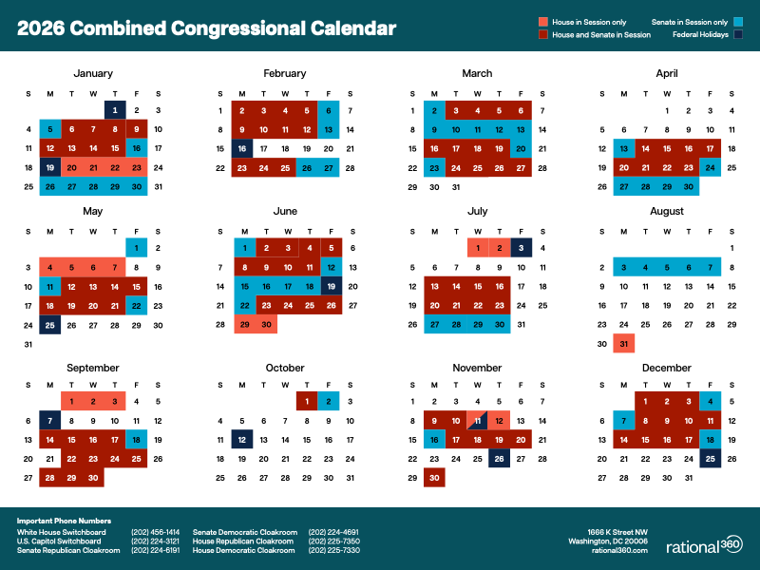

Slide 8
Presidential Power and Removal
Why might Congress want to restrict the President’s ability to remove executive branch officials at will?
(Try to think of both a “good” reason and a “bad” reason.)

Slide 9
Article II: removal of officers II
Constitutional Law I
Assignment #11
February 5, 2026

Slide 10
Myers v. United States
“[T]he President has the exclusive power of removing executive officers of the United States whom he has appointed by and with the advice and consent of the Senate.”

Slide 11
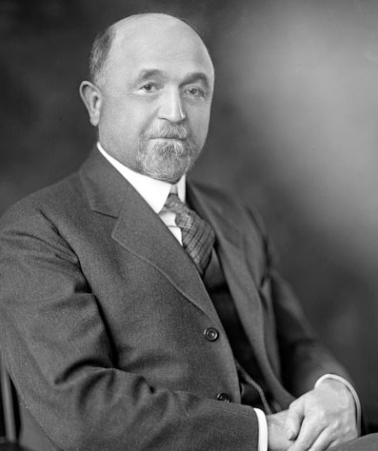
Humphrey’s Executor v. United States
William E. Humphrey
” [O]ne of the most colorful (if least effective) commissioners in the history of regulation.”

Slide 12
Humphrey’s Executor v. United States
“[W]hether the power of the President to remove an officer shall prevail over the authority of Congress to condition the power by fixing a definite term and precluding a removal except for cause will depend upon the character of the office; the Myers decision, affirming the power of the President alone to make the removal, is confined to purely executive officers . . . .”

Slide 13
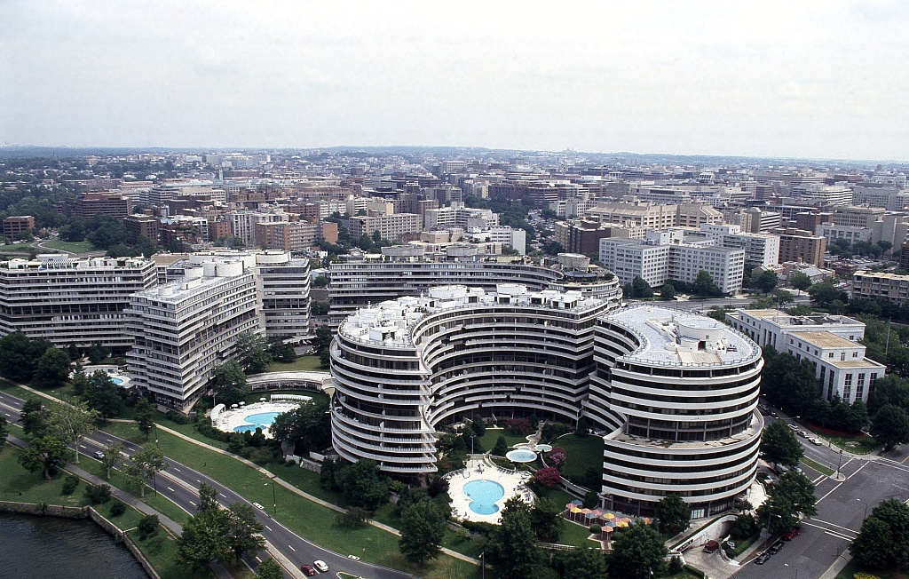
Morrison v. Olson: background

Slide 14
Morrison v. Olson: removal provision
"An independent counsel appointed under this chapter may be removed from office, other than by impeachment and conviction, only by the personal action of the Attorney General and only for good cause, physical disability, mental incapacity, or any other condition that substantially impairs the performance of such independent counsel's duties."

Slide 15
Morrison v. Olson: Appointments Issue
Is the independent counsel an inferior officer?
 | Majority: YES | Dissent: NO
1
2
3
4

Slide 16
Morrison v. Olson: Appointments Issue
Is the independent counsel an inferior officer?
 | Majority: YES | Dissent: NO
1 | subject to removal by higher executive branch official | This is relevant why?
2 | performs only certain, limited duties | Really? has all powers of AG, and then some
3 | limited in jurisdiction | Cf. Luxembourg
4 | limited in tenure | Not really limited: IC decides when to stop

Slide 17
Morrison v. Olson
“We undoubtedly did rely on the terms ‘quasi-legislative’ and ‘quasi-judicial’ to distinguish the officials involved in Humphrey's Executor and Wiener from those in Myers, but our present considered view is that the determination of whether the Constitution allows Congress to impose a "good cause"-type restriction on the President's power to remove an official cannot be made to turn on whether or not that official is classified as "purely executive." . . . [T]he real question is whether the removal restrictions are of such a nature that they impede the President's ability to perform his constitutional duty, and the functions of the officials in question must be analyzed in that light.”

Slide 18
Seila Law, L.L.C., v. CFPB
Our precedents have recognized only two exceptions to the President’s unrestricted removal power. In Humphrey’s Executor v. United States, we held that Congress could create expert agencies led by a group of principal officers removable by the President only for good cause. And in United States v. Perkins (1886) and Morrison v. Olson, we held that Congress could provide tenure protections to certain inferior officers with narrowly defined duties.

Slide 19
Removal hypothetical
Suppose that there is an official in the Internal Revenue Service (IRS) called the Chief Audit Officer (CAO). The CAO is responsible for deciding whether to perform tax audits of individuals based on statutory standards. By law, the decisions of the CAO can be reversed by the IRS Commissioner only for clear error. The CAO can only be removed by the Commissioner for cause. (The Commissioner can be removed by the President at will.)
Is the removal restriction on the CAO constitutional? What are the best arguments both ways?

Slide 20
https://www.justice.gov/opa/press-release/file/1462481/download

Slide 21
Article II: executive enforcement decisions
Constitutional Law I
Assignment #12
February 10, 2026

Slide 22
https://www.govinfo.gov/content/pkg/FR-2025-01-30/pdf/2025-02087.pdf
https://www.govinfo.gov/content/pkg/PLAW-118publ50/pdf/PLAW-118publ50.pdf

Slide 23
Article II: Foreign affairs
Constitutional Law I
Assignment #13
February 12, 2026

Slide 24
Zivotofsky v. Kerry questions
Question | Majority, con-currence answer | Dissents answer
Whether the President has exclusive power to grant formal recognition to a foreign sovereign
Whether Congress can command the President and Secretary of State to issue a formal statement that contradicts the earlier recognition
Yes
We don’t have to answer this question to decide this case
No
That’s not what’s happening here

Slide 25
https://youtu.be/a5wCl3aAMEQ
https://www.mapsofworld.com/where-is/jerusalem.html
https://www.jta.org/quick-reads/menachem-zivotofsky-whose-name-graces-two-supreme-court-cases-finally-gets-a-passport-listing-jerusalem-israel
https://history.house.gov/Institution/Session-Dates/All/

Slide 26
Separation of powers & nat’l security: Youngtown
Constitutional Law I
Assignment #3
February 17, 2026

Slide 27
War powers
Constitutional Law I
Assignment #14
February 24, 2026

Slide 28
Midterm Exam
Next Tuesday (3/3), in class
Open book, open notes (any print resources allowed)
To be taken in Exam 4, CLOSED mode (no file access)
2 Parts
Part I: multiple-choice questions (2).
  10 minutes recommended.
  Must be completed using multiple-choice tool in Exam4.
Part II: issue-spotter essay question (1)
  60 minutes recommended.

Slide 29
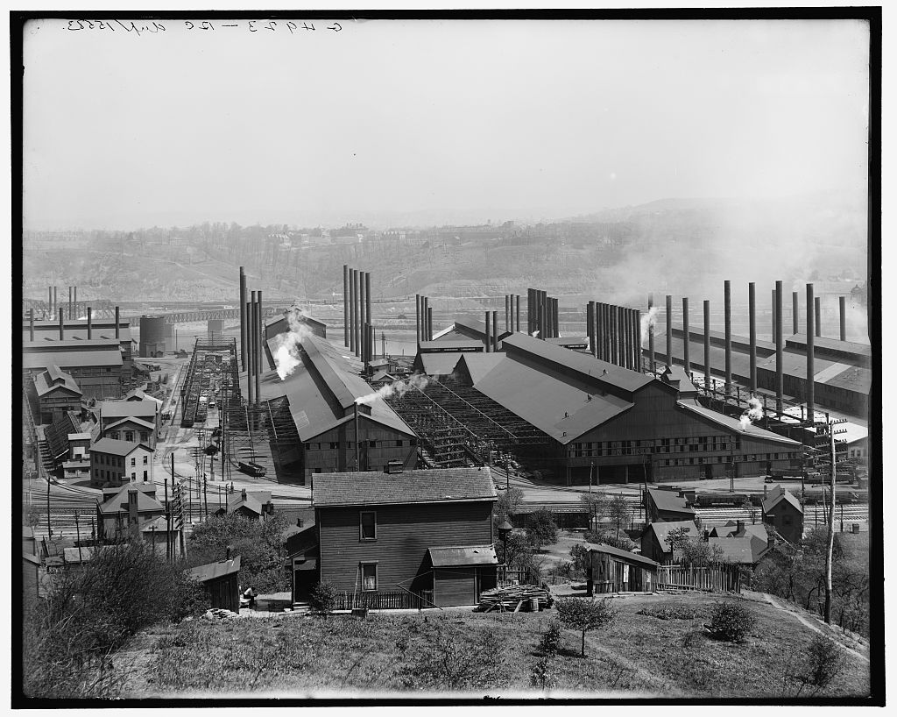

Slide 30
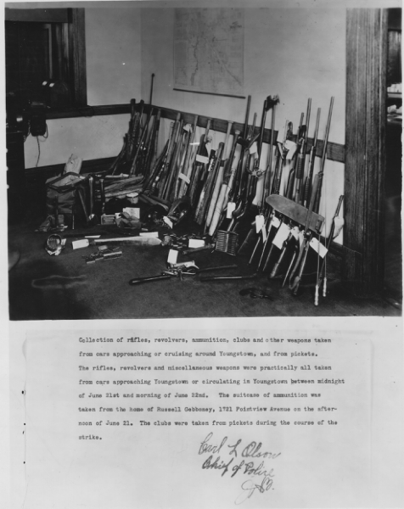
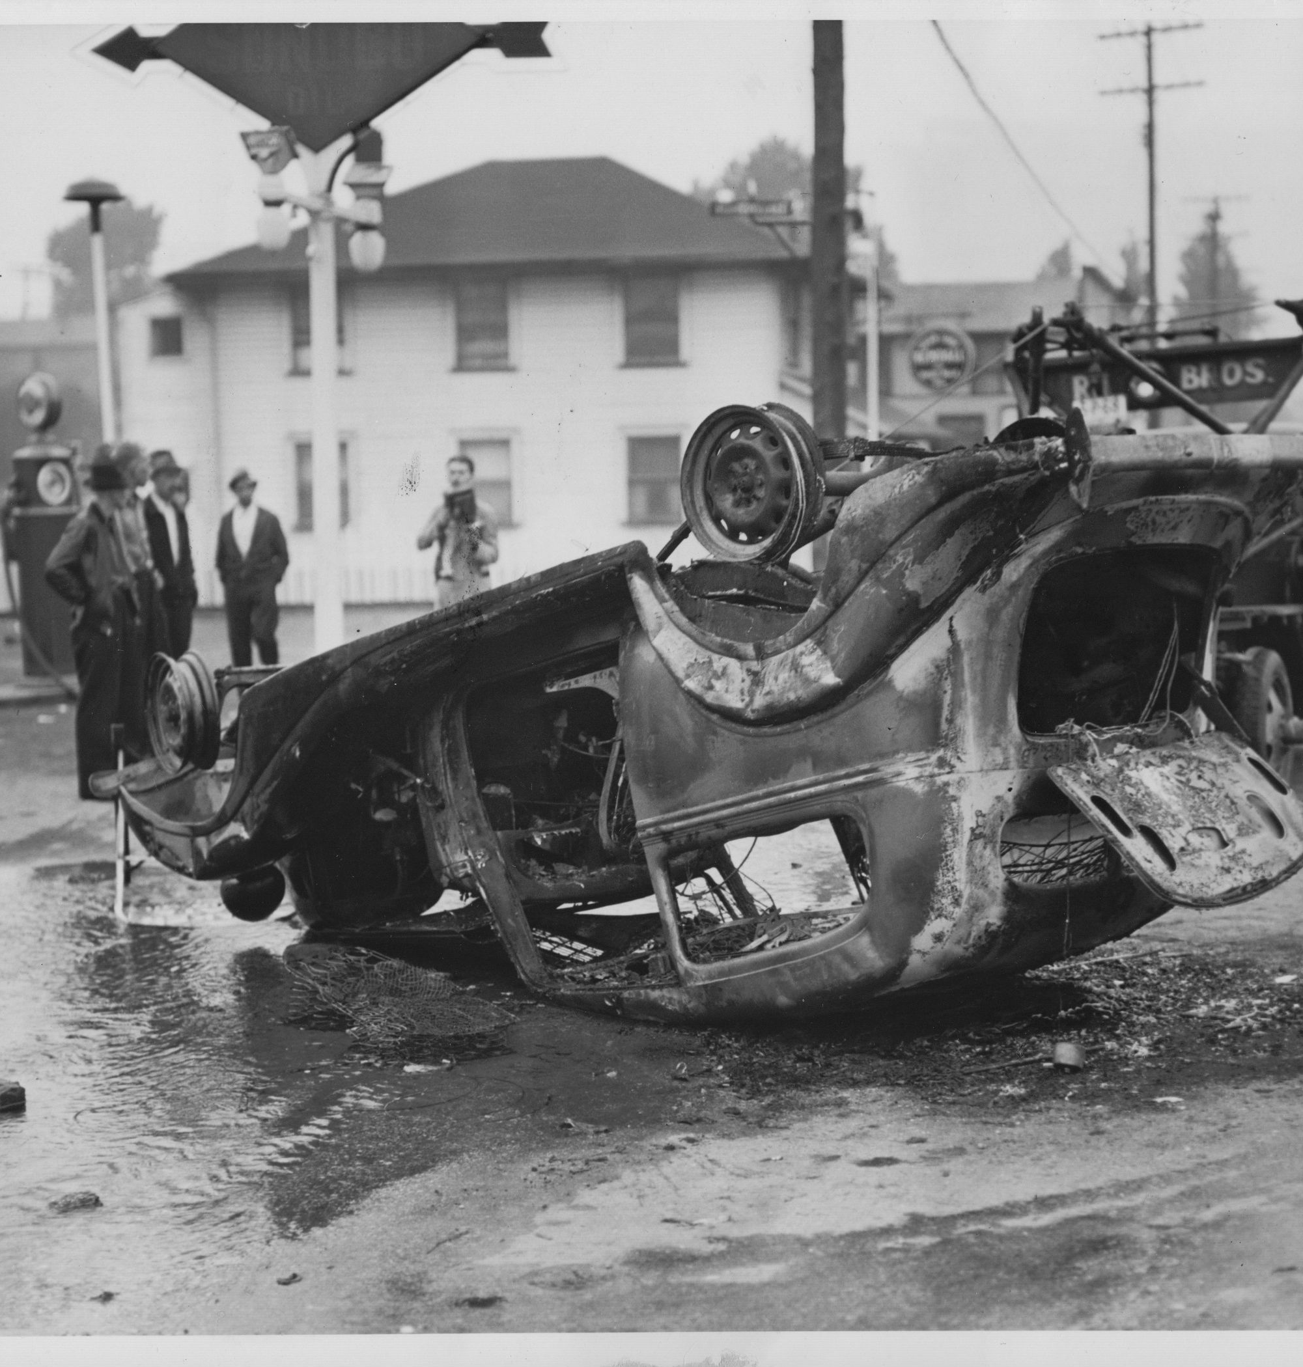

Slide 31
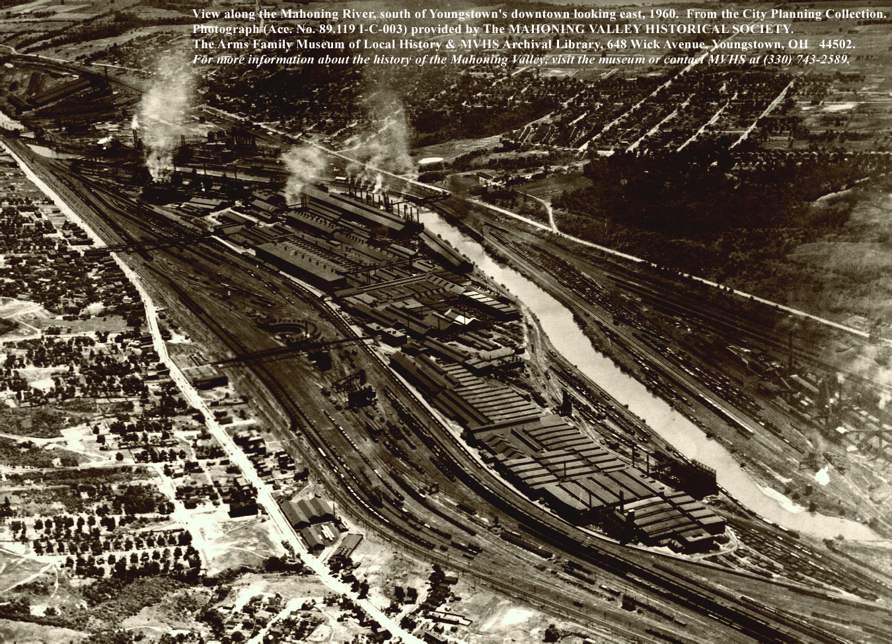

Slide 32
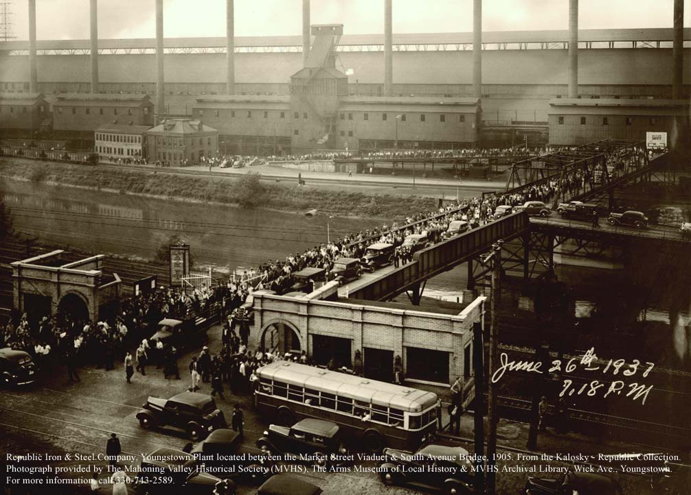

Slide 33
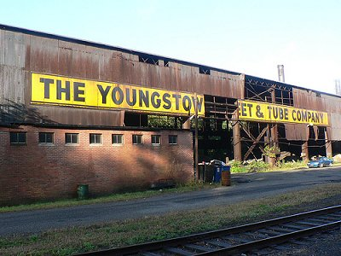

Slide 34
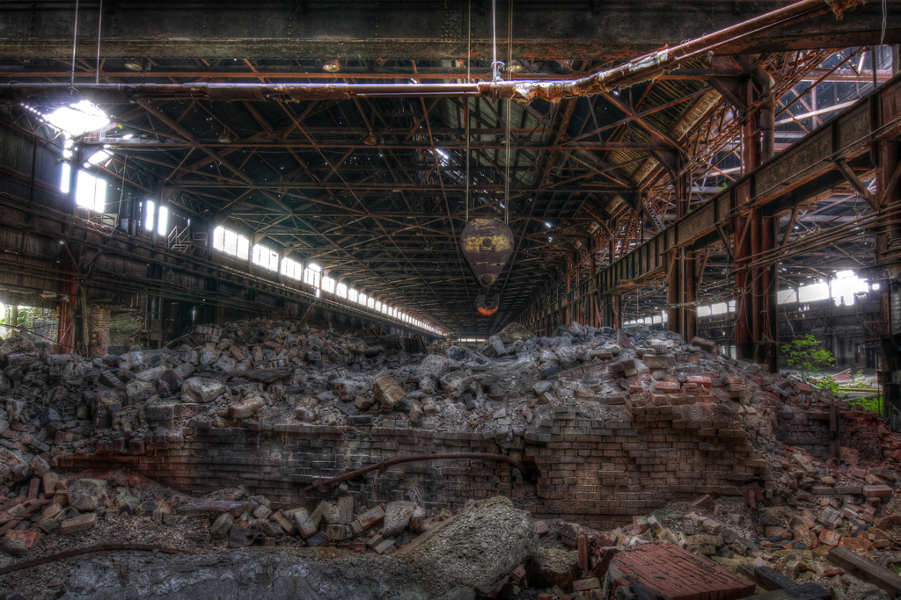

Slide 35
https://www.govinfo.gov/content/pkg/STATUTE-12/pdf/STATUTE-12-Pg255-3.pdf#page=3

Slide 36
War powers; exam review
Constitutional Law I
Assignment #15
March 5, 2026

Slide 37
https://www.senate.gov/legislative/LIS/roll_call_votes/vote1192/vote_119_2_00046.htm

Slide 38
